Slide 1
MA 276: Sports and statistics
Lecture 7: Statistics in hockey

Slide 2
Goals
Overview of hockey stats
Shot based metrics
Score adjustments
PDO
Tools
Bivariate tools: scatter plots, r
Heat maps
Logistic regression

Slide 3


Overview
-Grantland, 2014
-Rolling Stone, 2014

Slide 4


Shot based metrics
“in order to shoot the puck, you have to possess the puck” -JenLC
Corsi: shots on goal + missed shots + blocked shots
Fenwick: shots on goal + missed shots

Slide 5
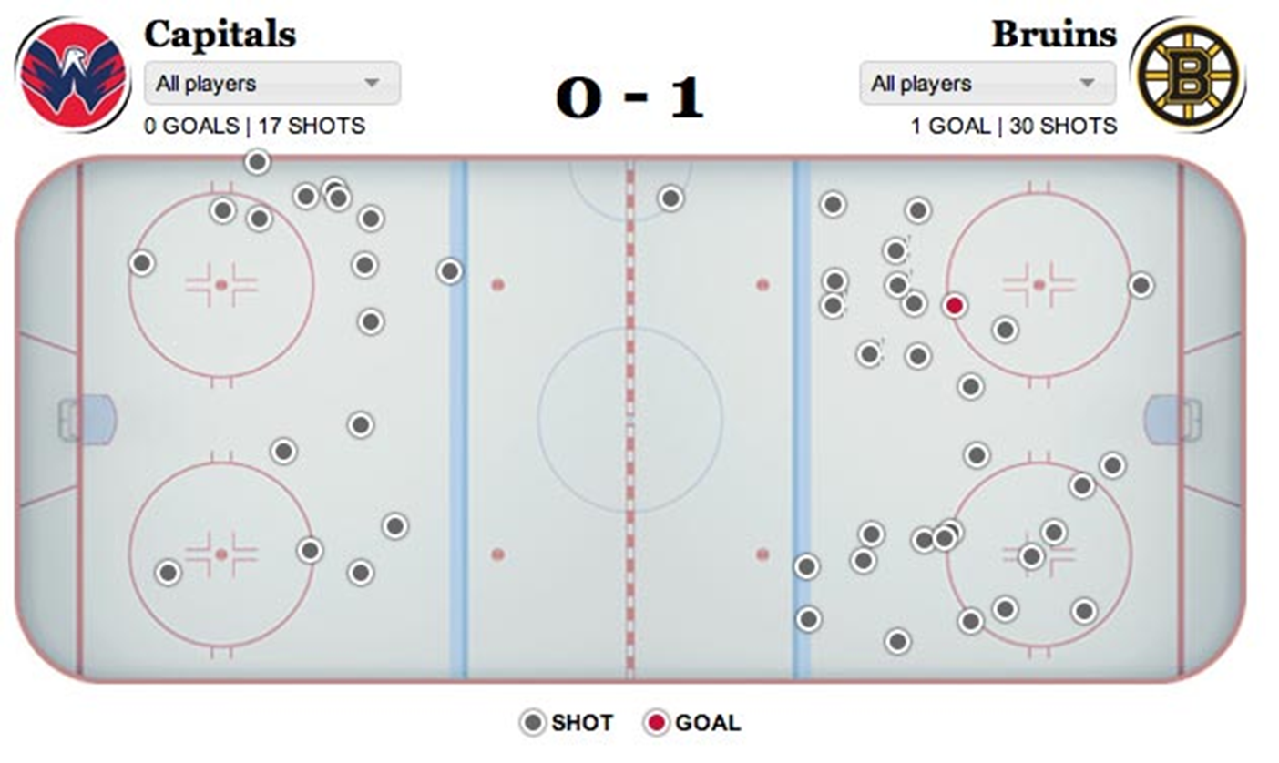
Shot based metrics
Corsi: shots on goal + missed shots + blocked shots

Slide 6
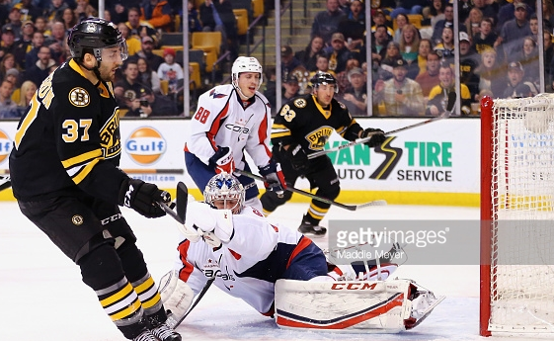
Shot based metrics
Corsi: shots on goal + missed shots + blocked shots (SAs)
Example: Patrice Bergeron
-On ice for 15 Boston SAs (CF = 15)
-On ice for 8 Washington SAs (CA = 8)
-Bergeron is a +7 for game (Corsi)
-Bergeron has a 65% CF%
How to interpret +7? How to interpret 65%?

Slide 7
Shot based metrics
Corsi: shots on goal + missed shots + blocked shots (SAs)
Example: Patrice Bergeron
Why Corsi?
-Strong correlation with future success
-Repeatable
Why not Corsi?

Slide 8
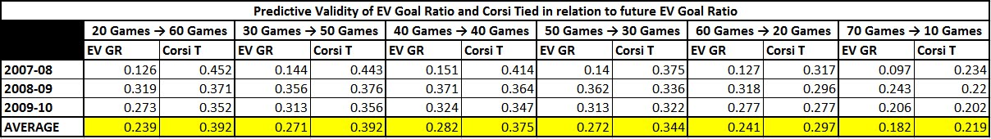
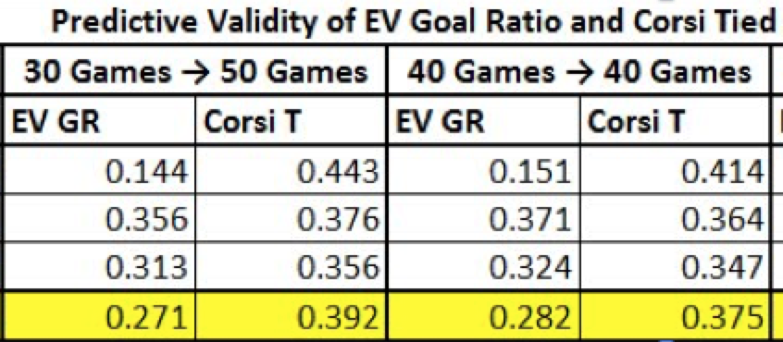
Shot based metrics
Corsi: shots on goal + missed shots + blocked shots (SAs)
Correlation to winning (via Jlikens):

Slide 9
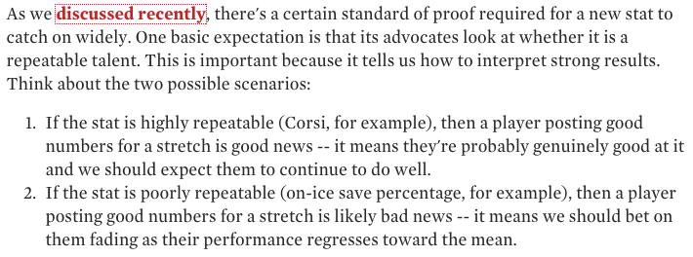
Shot based metrics
Corsi: shots on goal + missed shots + blocked shots (SAs)
Via ErikT:

Slide 10
Shot based metrics
Corsi: shots on goal + missed shots + blocked shots (SAs)
Example: Patrice Bergeron
CF60 = Corsi x 60/Time-on-ice
CorsiOff = Teammates number when player is off ice
CorsiRel = CF60 - CorsiOff
Bergeron’s 2016 CorsiRel = 7.97: Roughly 8 more shots per 60 even strength minutes were directed at opponents net while he was on the ice versus when he was off the ice

Slide 11
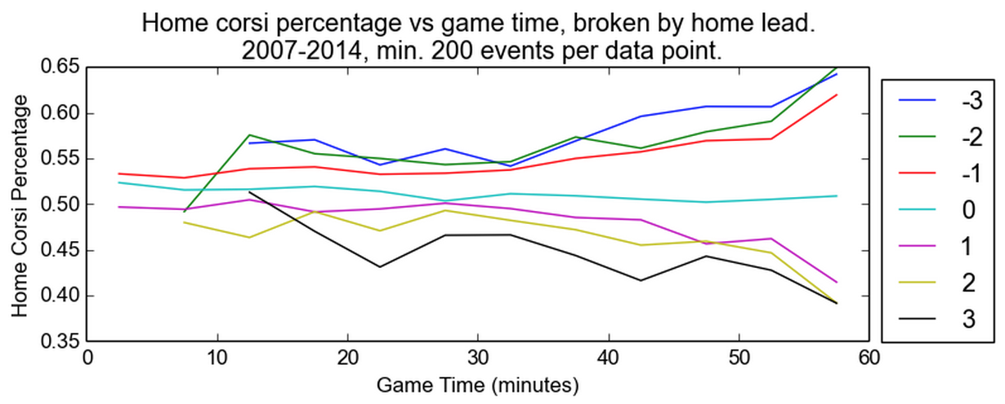
Shot based metrics
Corsi: shots on goal + missed shots + blocked shots (SAs)
Additional tweak: Score adjustments
-Only look at tied or close games? (no longer en vogue)
-Adjust for relative score differential (-2, -1, 0, etc) and shot differential during each game (weighted by time)
https://hockey-graphs.com/2014/11/13/adjusted-possession-measures/

Slide 12

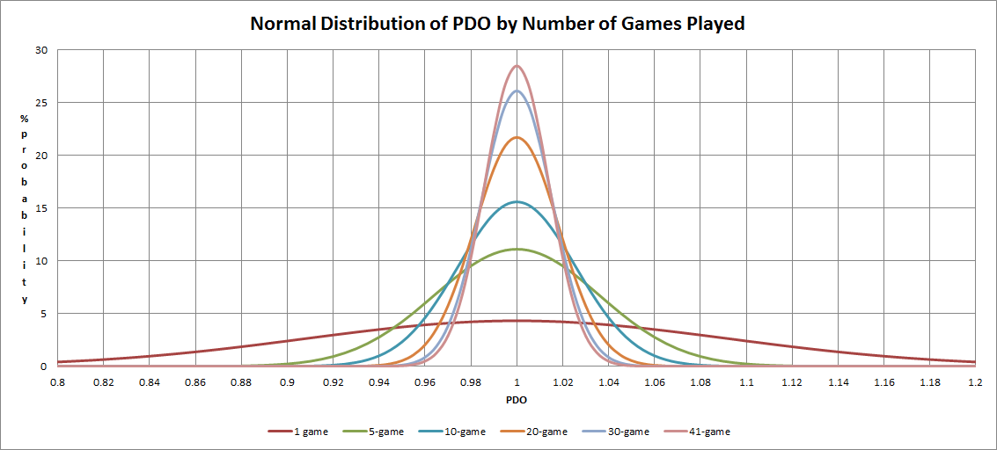
PDO
PDO: 5v5 shooting percentage + 5v5 save percentage

Slide 13
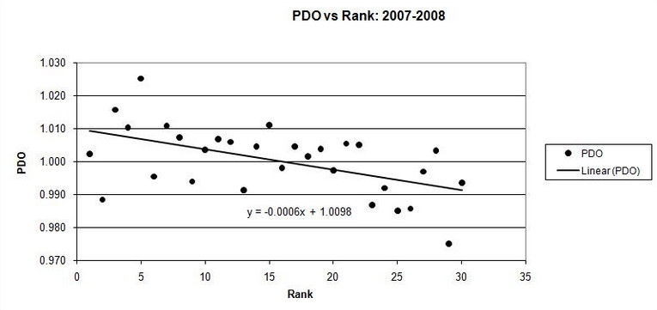
PDO
PDO: 5v5 shooting percentage + 5v5 save percentage
Strong ties to team performance

Slide 14
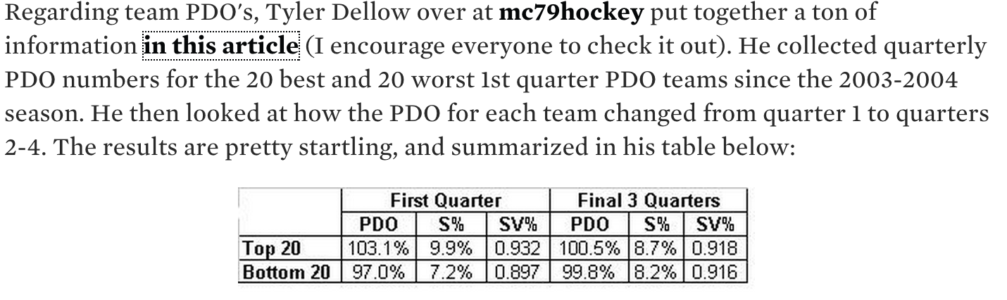
PDO
PDO: 5v5 shooting percentage + 5v5 save percentage
Less repeatable?
http://www.pensburgh.com/2010/6/23/1531707/pdo-and-what-it-means

Slide 15
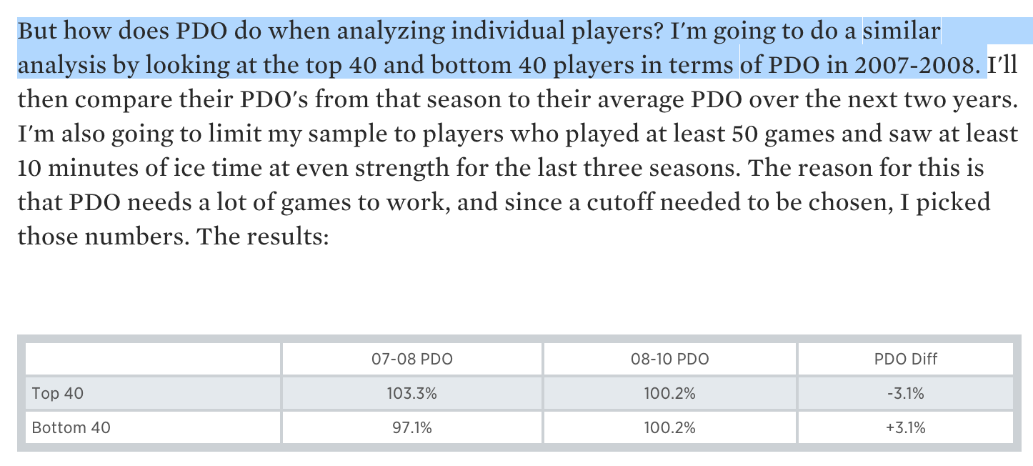
PDO
PDO: 5v5 shooting percentage + 5v5 save percentage
Less repeatable?
http://www.pensburgh.com/2010/6/23/1531707/pdo-and-what-it-means

Slide 16
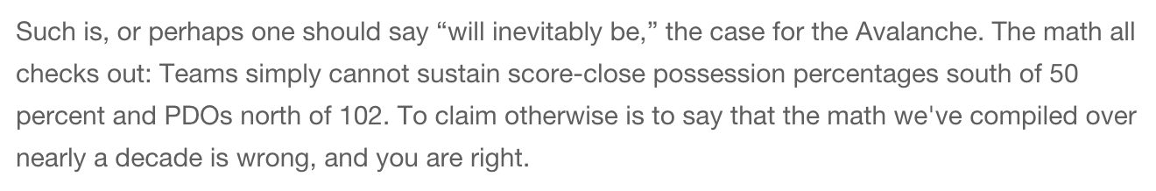
PDO
PDO: 5v5 shooting percentage + 5v5 save percentage
How can PDO predict the future?

Slide 17
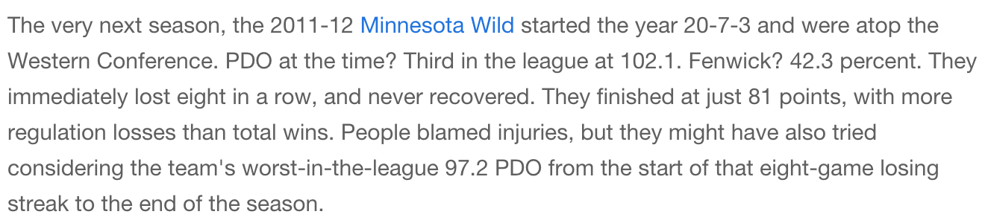
PDO
PDO: 5v5 shooting percentage + 5v5 save percentage
How can PDO predict the future?

Slide 18
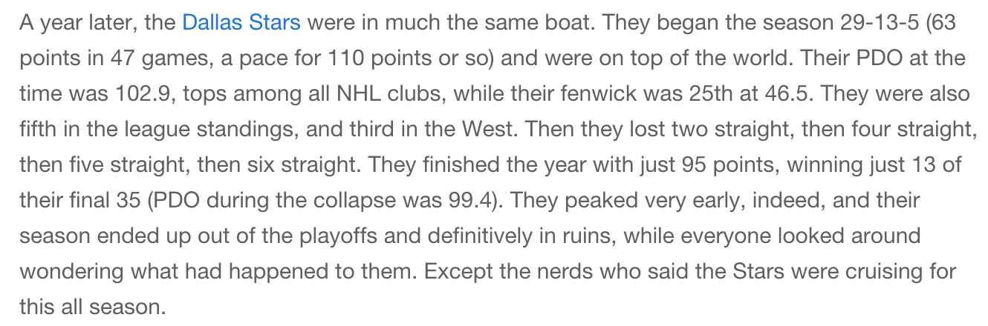
PDO
PDO: 5v5 shooting percentage + 5v5 save percentage
How can PDO predict the future?

Slide 19
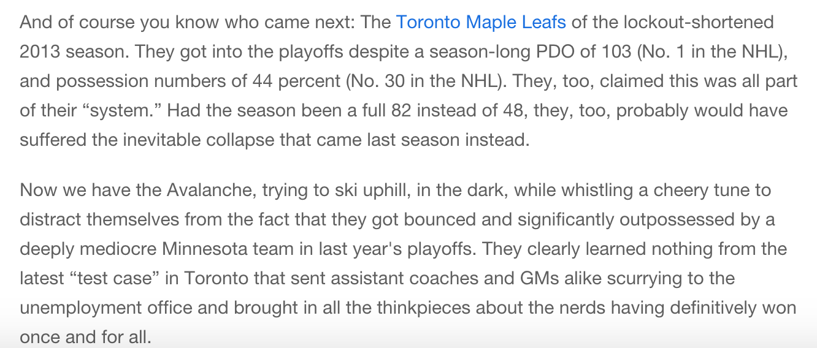
PDO
PDO: 5v5 shooting percentage + 5v5 save percentage
How can PDO predict the future?

Slide 20
PDO
No Goals
Good Luck
Bad Luck
Goals For Everyone
League Averages*
Shooting %: 7.35%
Save % : 92.6%
Avg 5v5 (2016)
95%
Save %
(Sv%)
90%
Shooting %
(Sh%)
5%
10%

Slide 21
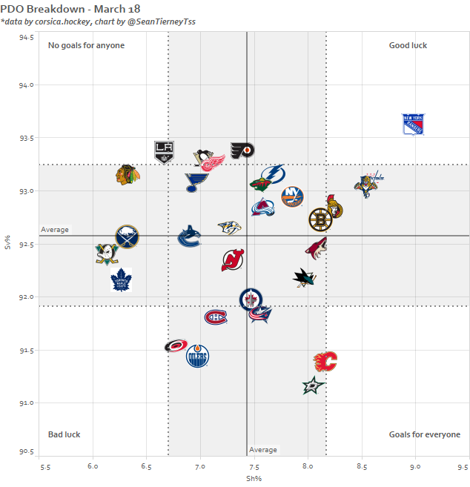
PDO
https://public.tableau.com/profile/sean.tierney#!/

Slide 22
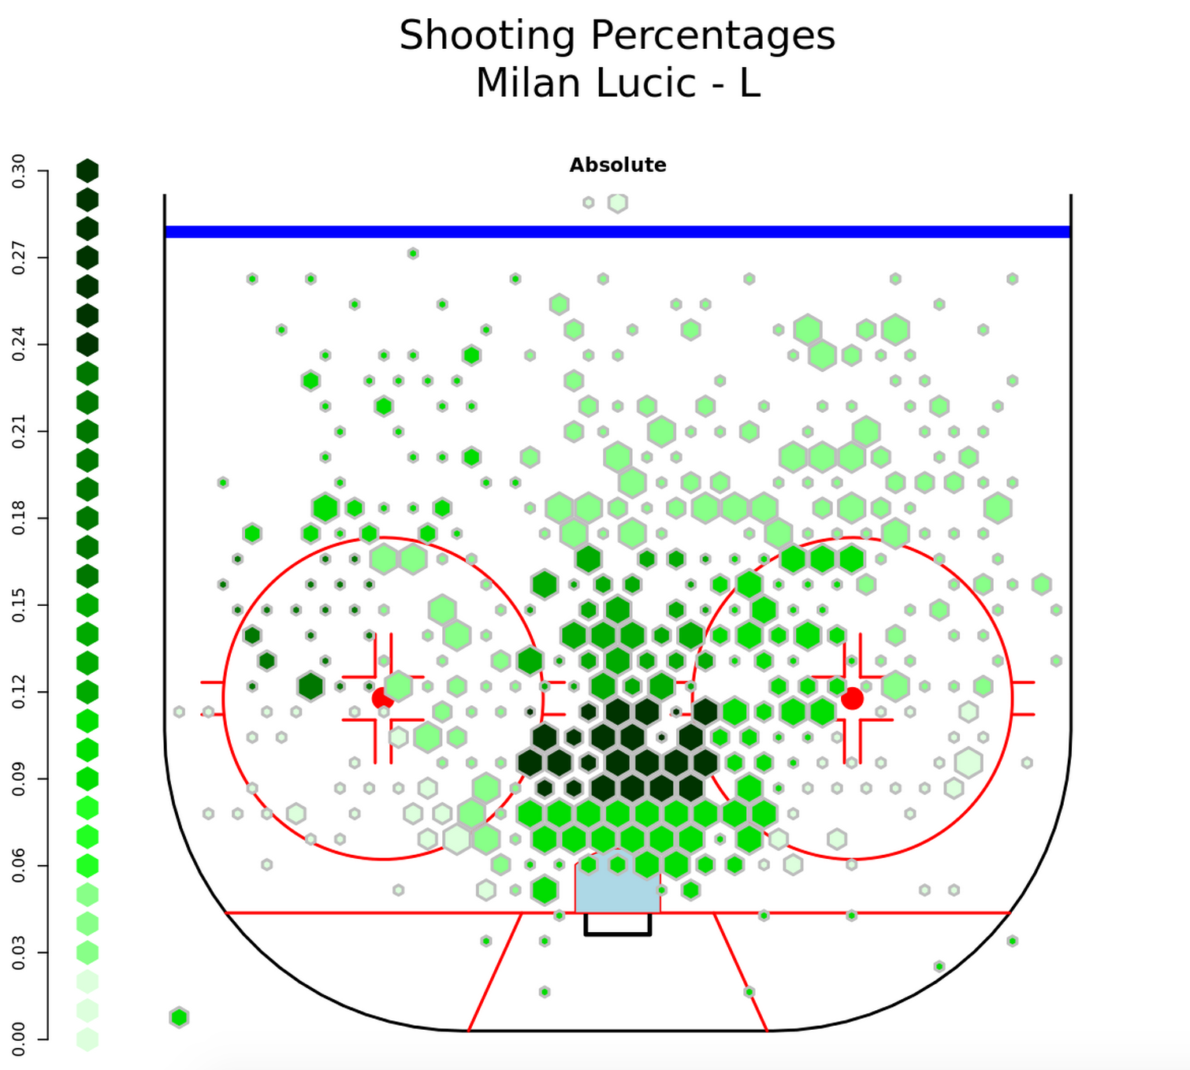
Additional tools: heatmaps
war-on-ice.com

Slide 23
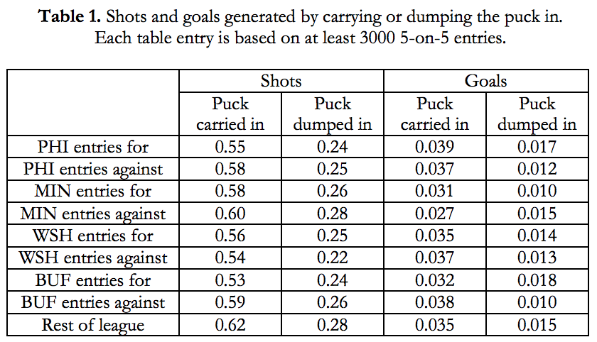
Additional tools: zone entry
http://www.sloansportsconference.com/?p=10561

Slide 24
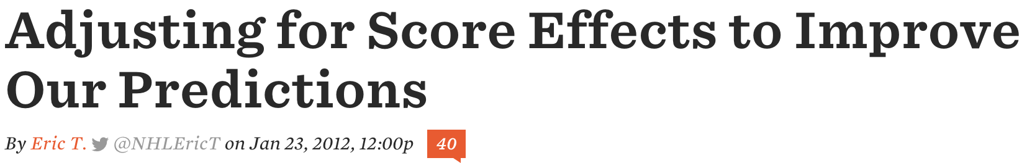
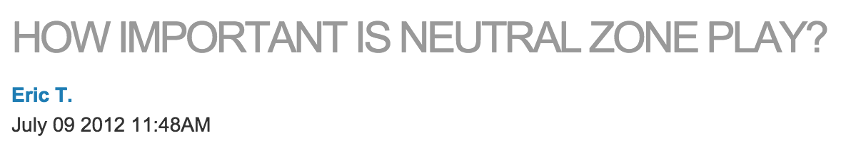
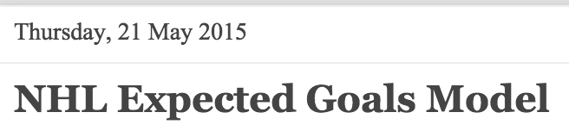
Articles to read and discuss:
http://www.broadstreethockey.com/2012/1/23/2722089/score-adjusted-fenwick
http://nhlnumbers.com/2012/7/9/how-important-is-neutral-zone-play
http://donttellmeaboutheart.blogspot.com/2015/05/nhl-expected-goals-model.html

