Slide 1
MA 276: Sports and statistics
Lecture 6: Statistics in basketball

Slide 2
Goals
Overview of basketball stats
Possession based metrics
Tools
Bivariate tools: scatter plots, r
Efficiency & rate statistics
Heat maps
Logistic regression

Slide 3
Overview
1 – Possession based metrics
-What’s wrong with counting stats?
2 – Shifts in strategy
-Increased use of 3-pointer
3 – Next steps

Slide 4
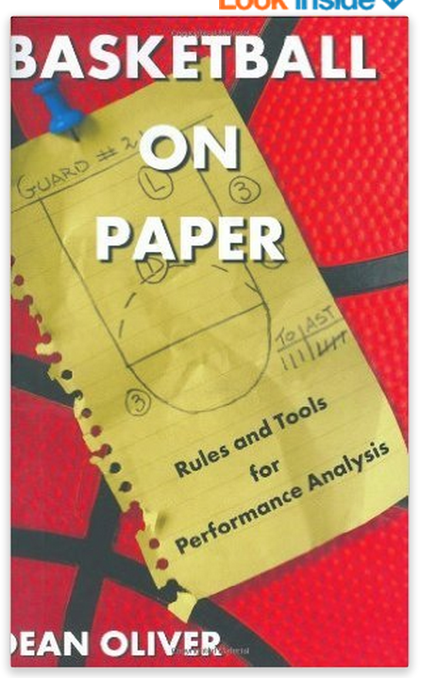
Overview & (a few) names to know
Dean Oliver
Wayne Winston
John Hollinger
Roland Beech

Slide 5
Possession Based Metrics
“A starting point for analyzing basketball statistics”
-Kubatko, Oliver, Pelton, Rosenbaum
-How to define a possession? For game i,
Poss_{i} = FGA_{i} + 0.44*FTA_{i} –OREB_{i} + TO_{i}
-More complicated formulas exist: above example shows correlation coefficient of 0.97 with actual possessions
-Average # in a game?

Slide 6
Why possessions
1 – Team-level talent adjustments
-Which is better? A 10-point win in a 100 or 150 possession game?
2 – Player level adjustments
-Easier to score 30 points in a 100 or 150 possession game?
3 – Rates > Counting metrics
-Examples in other sports

Slide 7
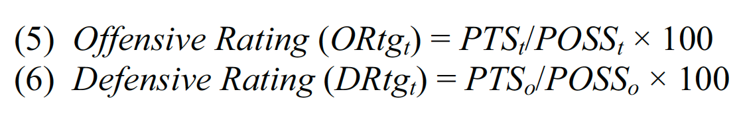
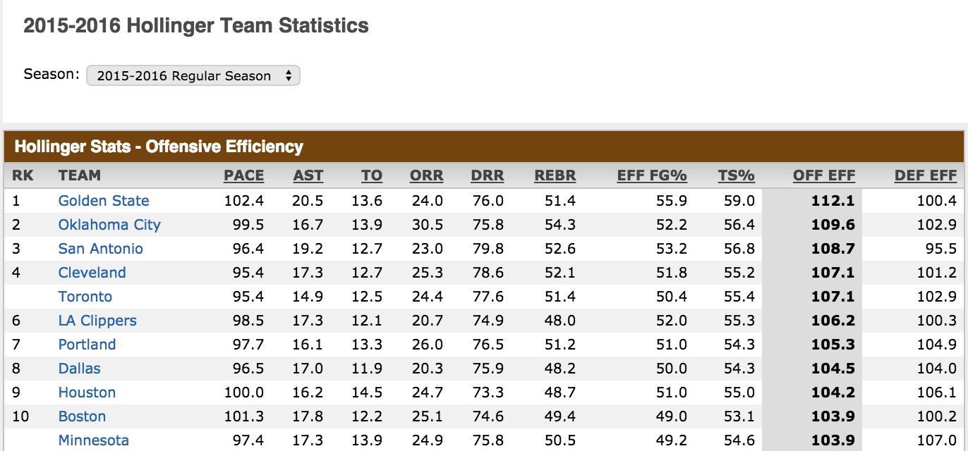
Offensive/Defensive ratings
-Reflect both efficiency and pace

Slide 8
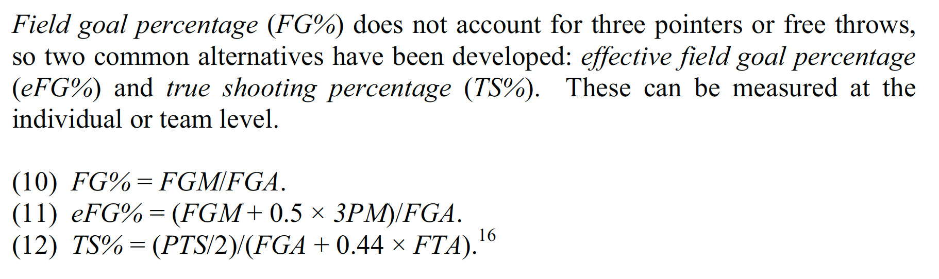
Player-specific rate statistics
eFG% and TS% reflect varying shot values (1, 2, 3):
  - Similarities? Differences?
  Similar rate statistics for rebounds

Slide 9
Extensions
“Four Factors”
“Plus-minus”
eFG%
Turnovers per possession
Offensive rebounding percentage
Free throw rate (FTM/FGA)
Points (or rating) when player on the court – Points (rating) when off the court
    Often adjusted for game or teammates
    Real plus-minus (Deadspin article)

Slide 10
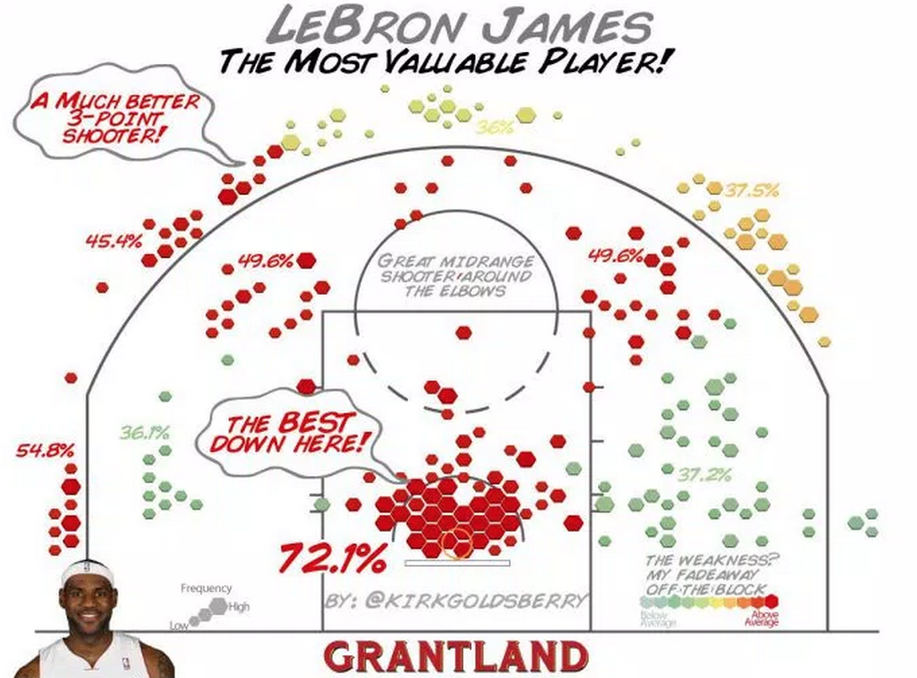
Extensions: shot charts

Slide 11
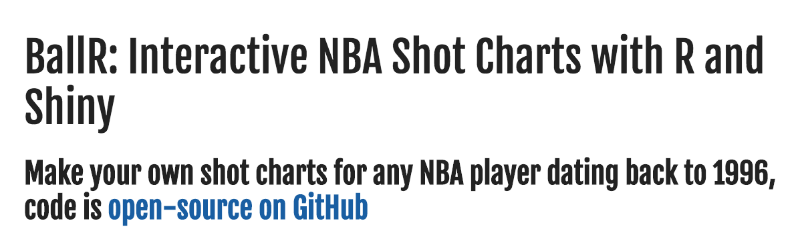
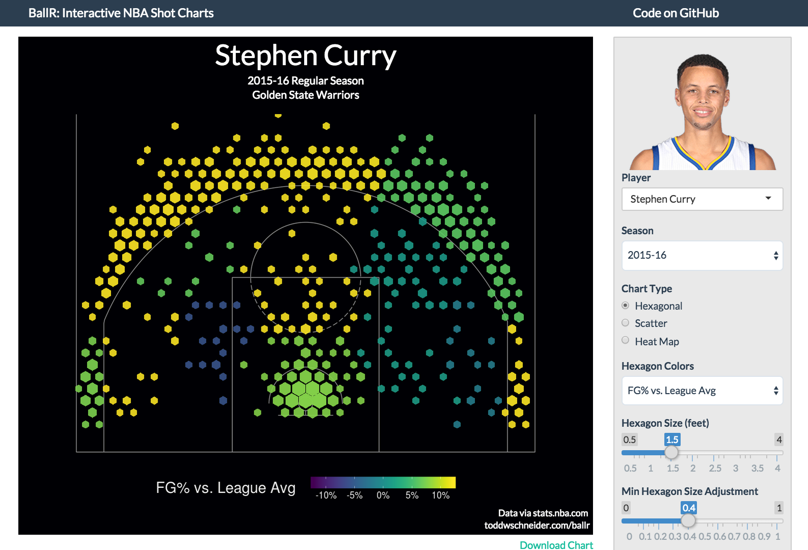
Extensions
http://toddwschneider.com/posts/ballr-interactive-nba-shot-charts-with-r-and-shiny/

Slide 12
State of current metrics
Using metrics on previous slides, consider what’s important as far as:
1 – Importance to winning
2 – Player-specific contributions (less team dependent)
3 – Repeatability

Slide 13
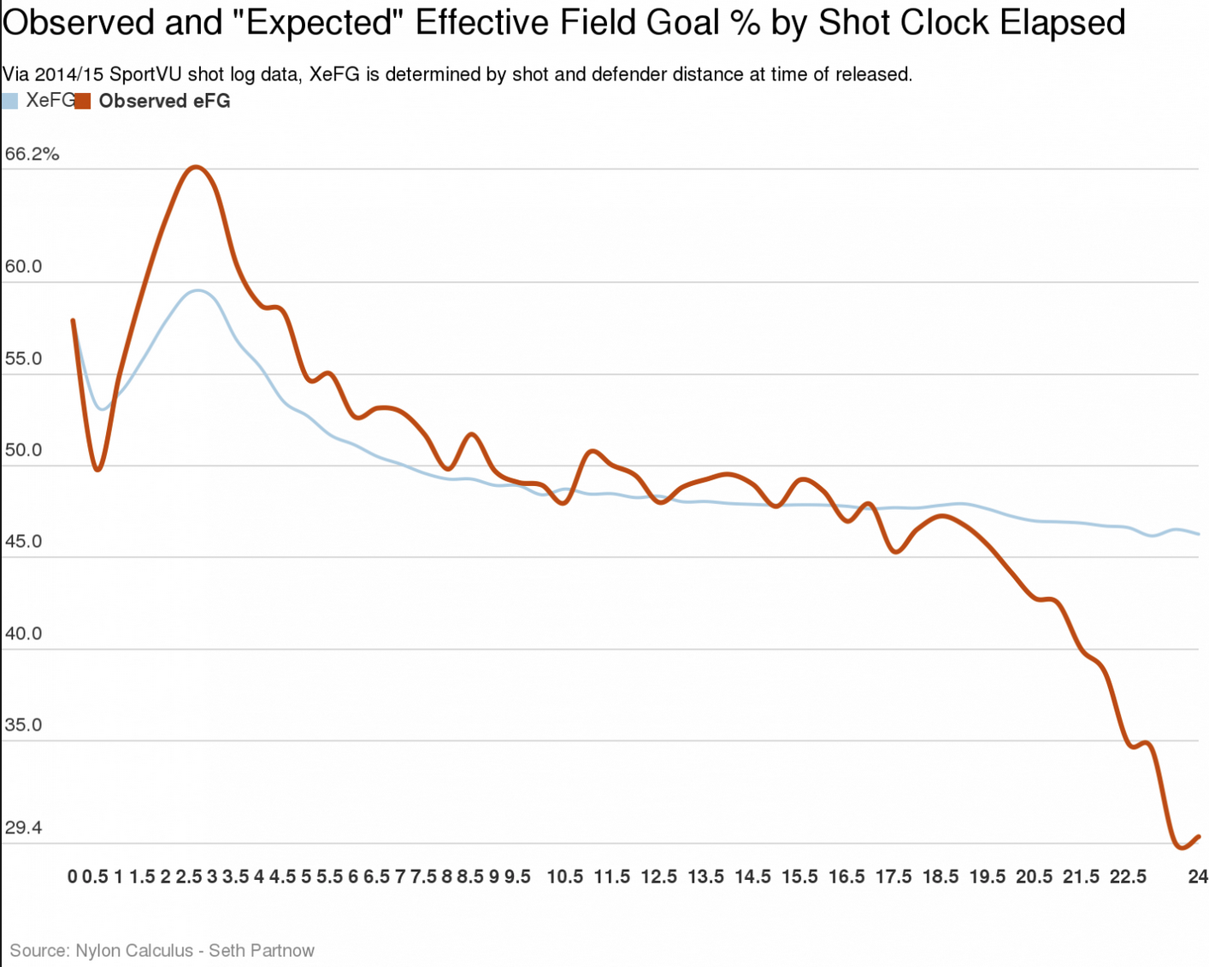
Adjustments: by shot time
https://www.washingtonpost.com/news/fancy-stats/wp/2015/08/28/ty-lawson-will-help-rockets-rely-less-on-james-harden/

Slide 14
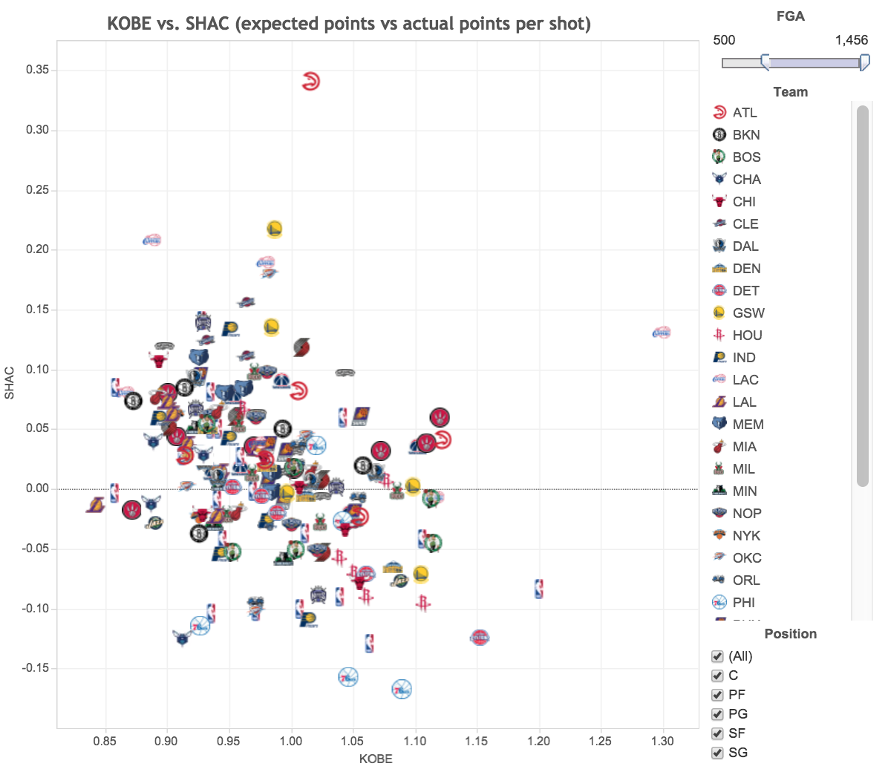
Adjustments: by shot quality
http://nyloncalculus.com/2015/09/28/introducing-kobe-a-measure-of-shot-quality/

Slide 15
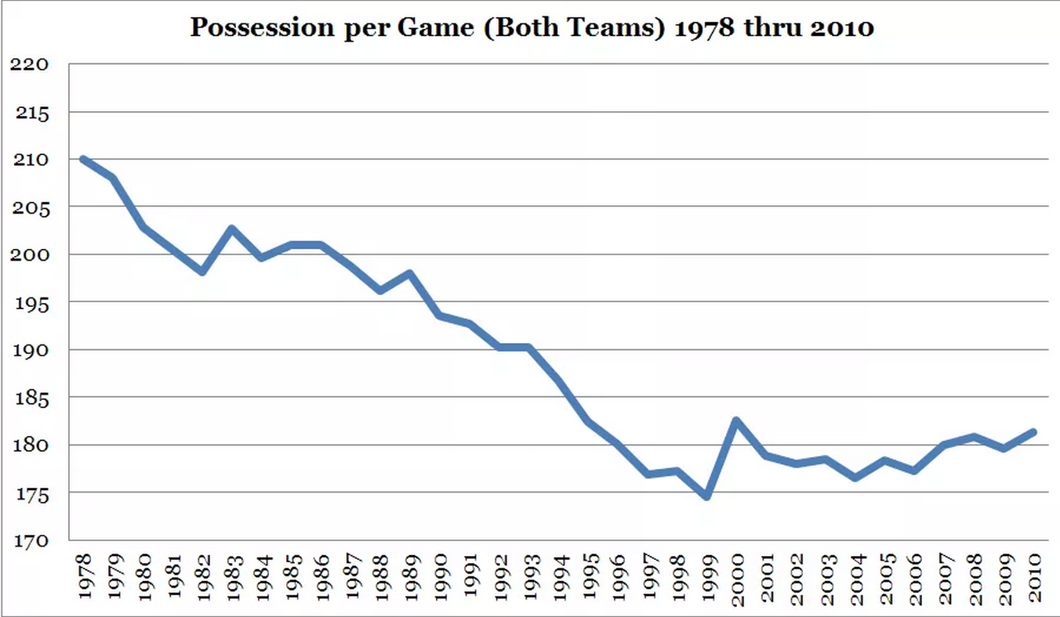
Adjustments: by era
http://basketballnumbers.com/2010/07/19/measuring-the-quality-of-basketball-in-the-nba-part2-adjusting-for-pace/

Slide 16
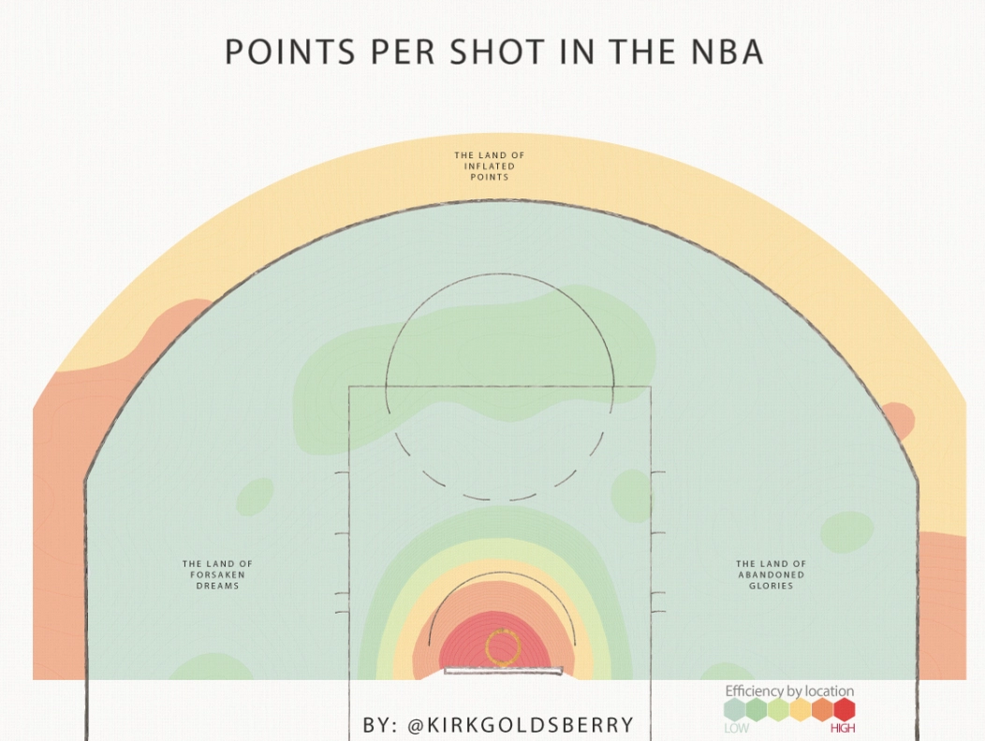
The three pointer
http://grantland.com/the-triangle/is-it-time-to-move-the-nba-3-point-line-back/

Slide 17
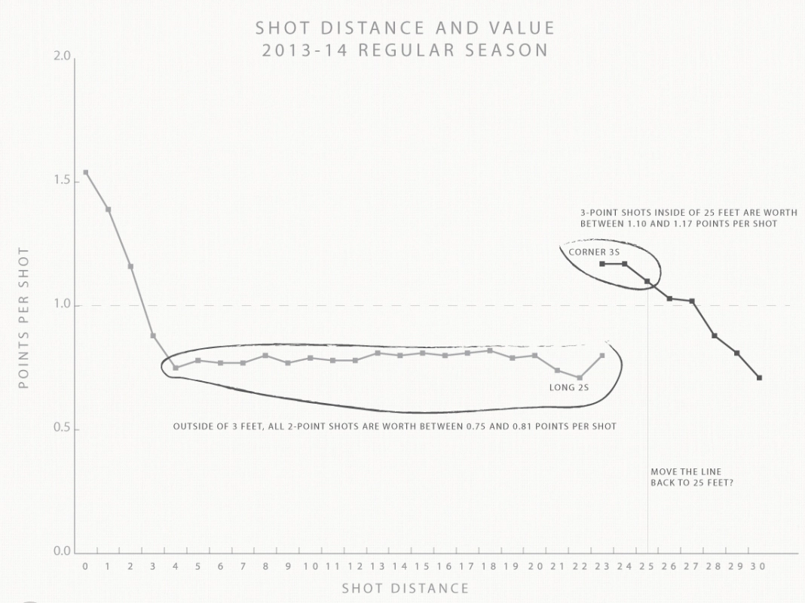
The three pointer
http://grantland.com/the-triangle/is-it-time-to-move-the-nba-3-point-line-back/

Slide 18
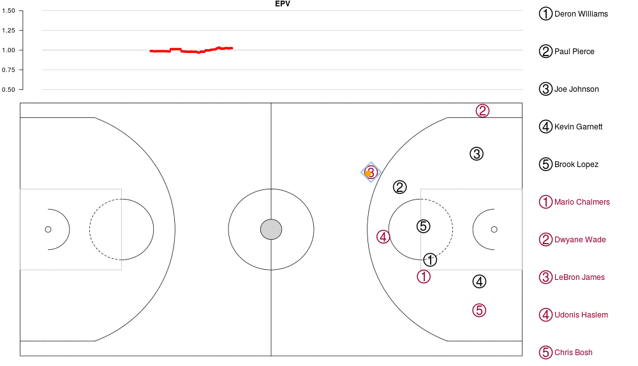
The future
https://github.com/dcervone/EPVDemo/blob/master/EPV_demo.pdf

