Slide 1
MA 276: Sports and statistics
Lecture 5: NFL, expected points, game theory

Slide 2
Goals
Expected points
NFL game theory & decision making
Tools
Expected value
Review of logistic regression

Slide 3
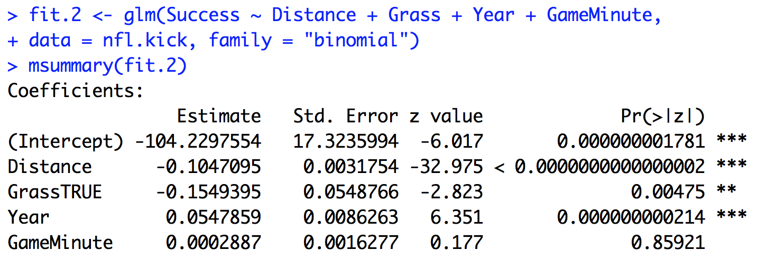
From last week:
Summary: odds ratios, z-test statistics, predicted probabilities

Slide 4
Link to expected points:
Transform logistic regression model into probabilities
predict() function (or by hand)
Example:
P(Success = 1 | Dist = 40, Grass = TRUE, Yr= 2010, GM = 10) = 0.82
Expected points: E(X_{i}) = x_{i}*p_{i}
3*0.82 = 2.46 points
Interpretation:

Slide 5
Link to expected points:
So kicking a field goal attempt is worth 2.46 points. What else?
Other possible decisions:
-Go for it
-Punt it?
All possible outcomes:
-Successful fourth down conversion
-Successful field goal
-Missed fourth down conversion
-Missed field goal
-Disaster plays

Slide 6
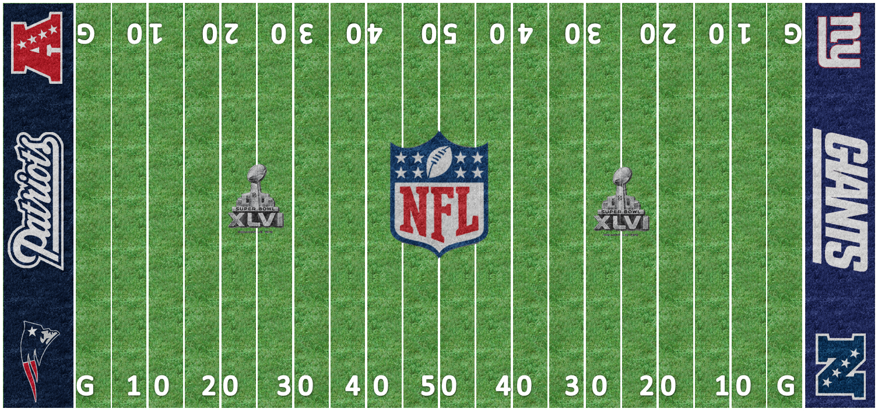
Formal definition:
“Given any combination of down, yards to go, and distance from the end zone, the expected value of the points from that position are equal to the average of every next score from that position.” - Causey
Function of 3 play-specific characteristics: down, distance, yard line.

Slide 7
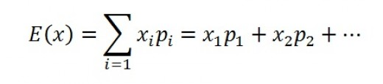
Some probability:
Expectation of random variable X
E(X) = 7(0.4) + 3(0.2) – 3(0.2) – 7(0.2) = 1.4
x | 7 | 3 | -2 | -3 | -7
p | 0.4 | 0.2 | <0.01 | 0.2 | 0.2

Slide 8
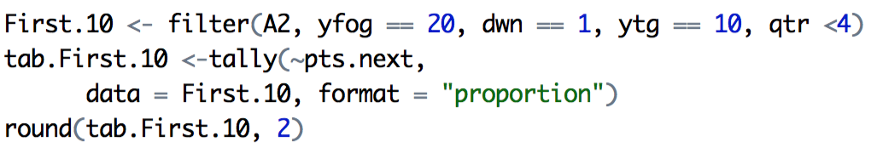
Expected value calculations
Point totals fixed – stated in terms of offense
-8, -7, -6, -3, -2, 0, 2, 3, 6, 7, 8
Probabilities are the probability that each point total is the next one scored
Conditional on down, distance, yard line
Ex: First and 10 from own 20-yard line

Slide 9
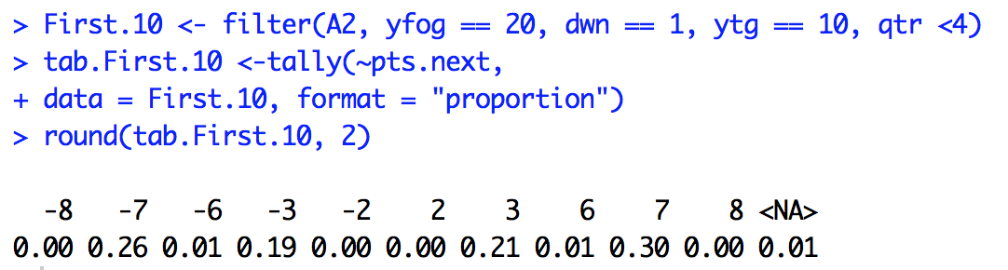
Expected value calculations
Ex: First and 10 from own 20-yard line
E(X) =

Slide 10
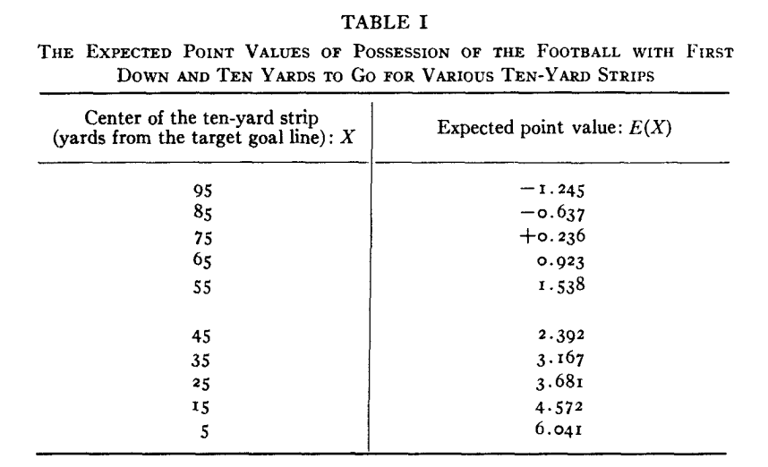
Expected value estimates
-Carter/Machol, 1971

Slide 11
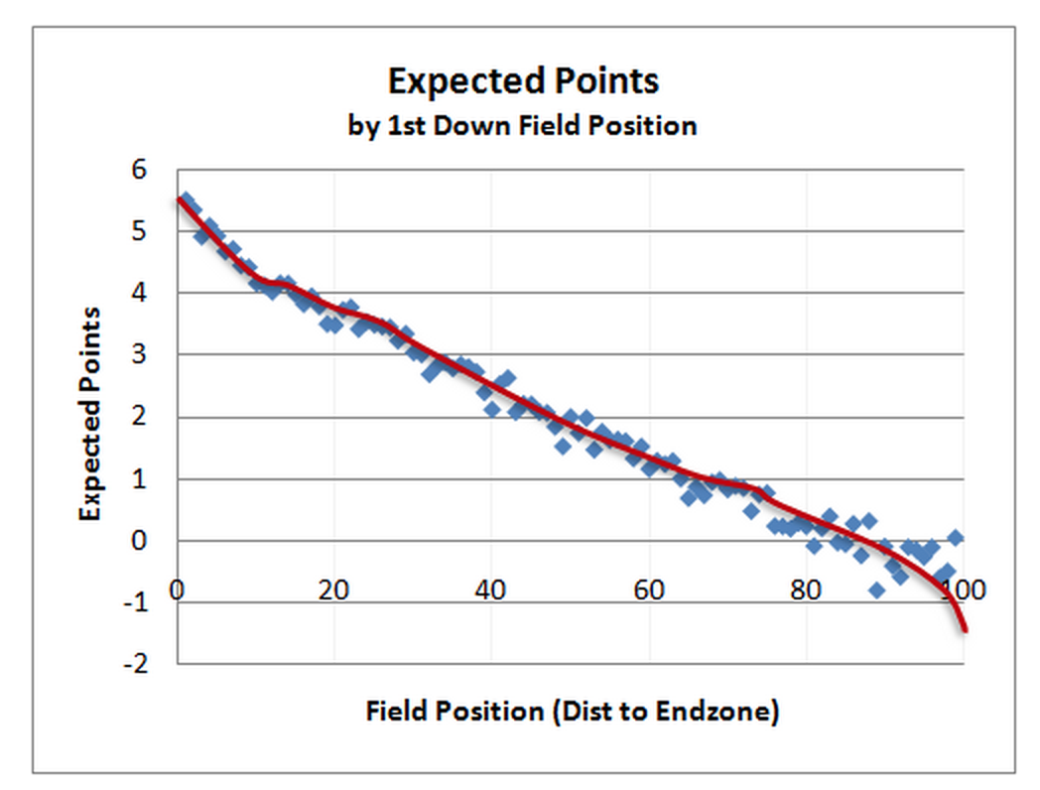
Expected value estimates
-Burke, 2010

Slide 12
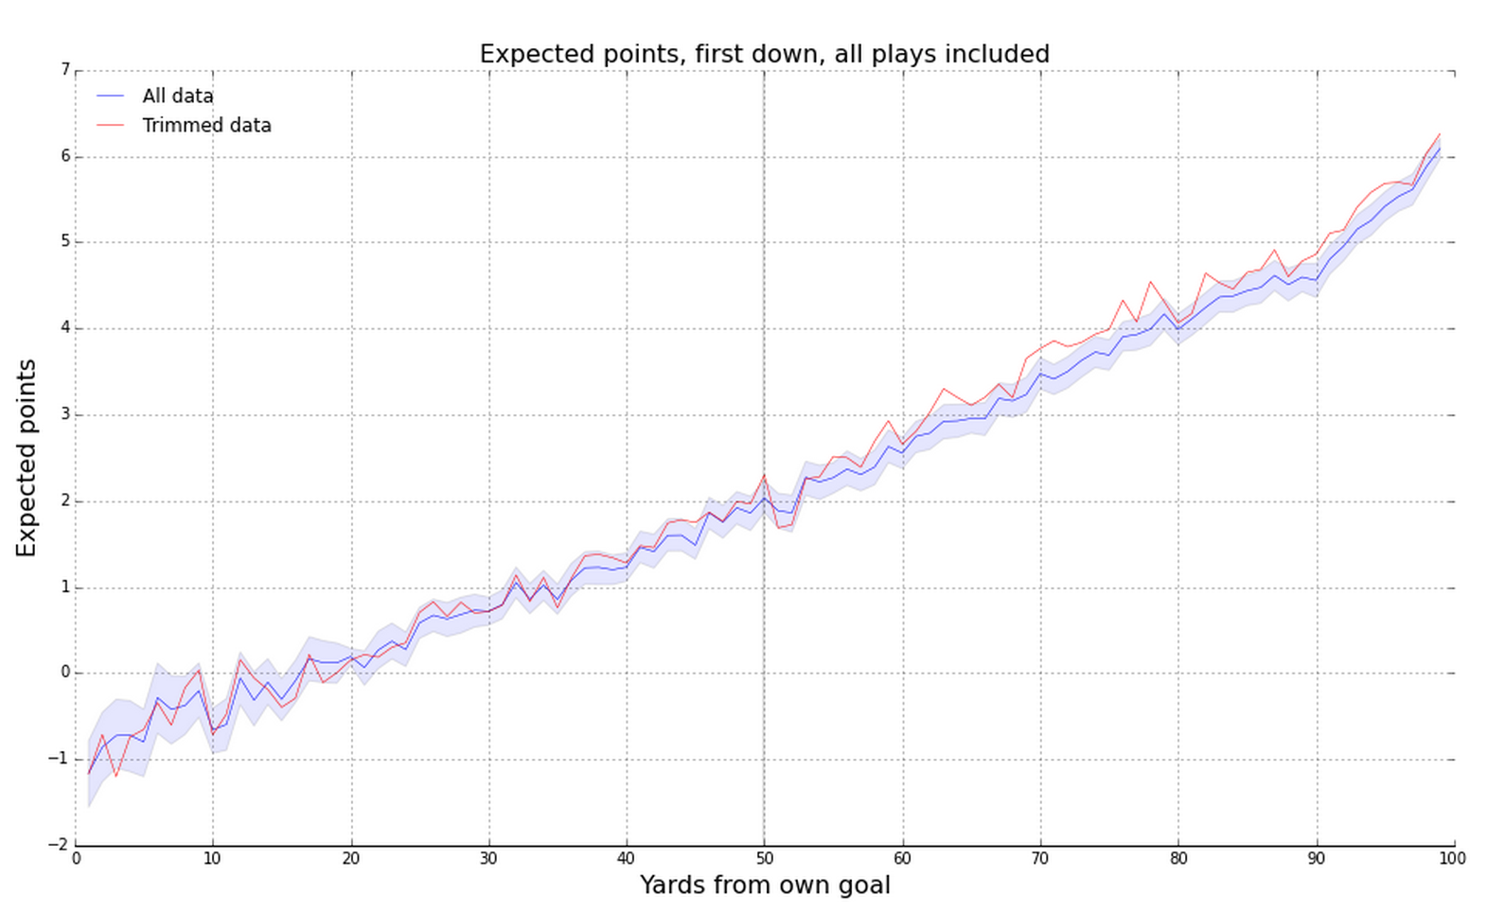
Expected value estimates
-Trey Causey, 2015

Slide 13
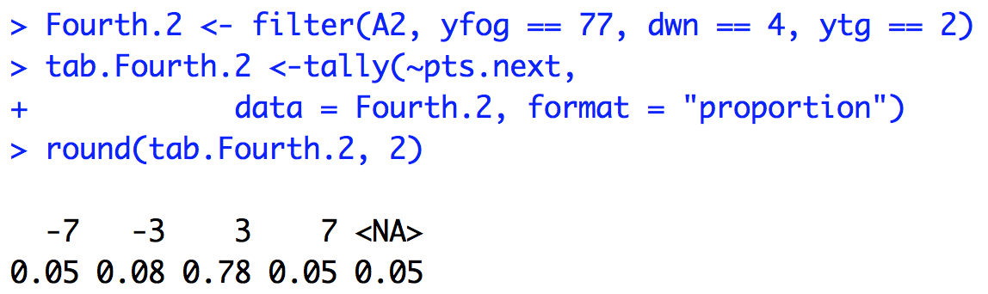
Expected points and NFL decisions
Example:
4th - 2 from opponents 23-yard line
E(X) = 2.1

Slide 14
Expected points and NFL decisions
Example:
4th - 2 from opponents 23-yard line
Issues with estimated E(X) = 2.1
1:
2:
How to handle:
1:
2:

Slide 15
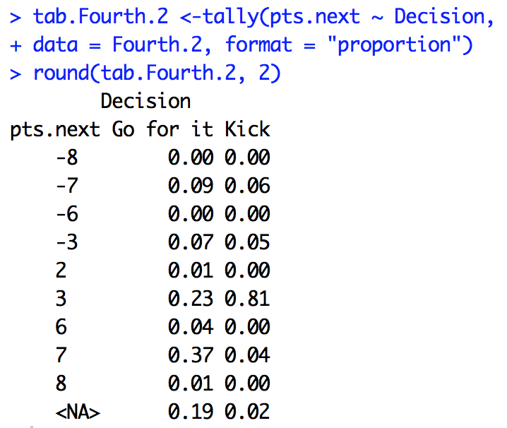
Expected points and NFL decisions
4th - 2 from opponents 23-yard line
Borrow information:
Split by decision:

Slide 16
Expected points and NFL decisions
4th - 2 from opponents 23-yard line
Go for it:
E(X) = 2.81
Kick it:
E(X) = 2.14
What do coaches do?

Slide 17
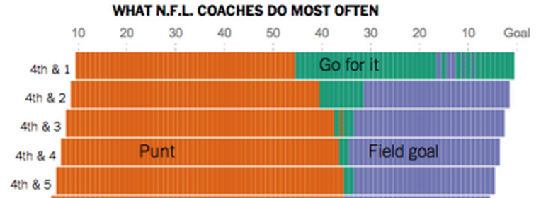
Expected points and NFL decisions
Fourth and 2, opponents 23 yard line
Going for it ~ 2.8 expected points
Field goal ~ 2.1 expected points
In reality, coaches kick field goal roughly twice as often in this example

Slide 18
Expected points and NFL decisions
Details
Quarters 1/3 & closer games receive priority
Extensions: Expected points added
- Ex 1: Kicker value
- Ex 2: Play value
- Ex 3: Play choice
- Win probability models
Weaknesses: Not all points created equally

Slide 19
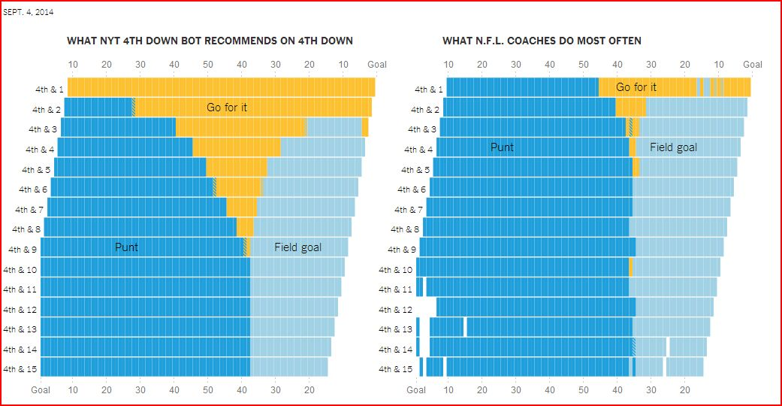
NFL Decisions

Slide 20
NFL Decisions
Reasons for passive strategy
Minimax
Prospect theory
Risk aversion

Slide 21
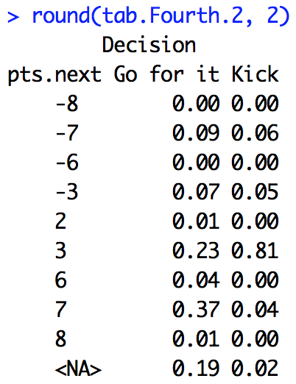
NFL Decisions: Minimax
Minimax: decision that minimizes possible loss in worst case scenario
Ex: 4th and 2 from opponents 23

Slide 22
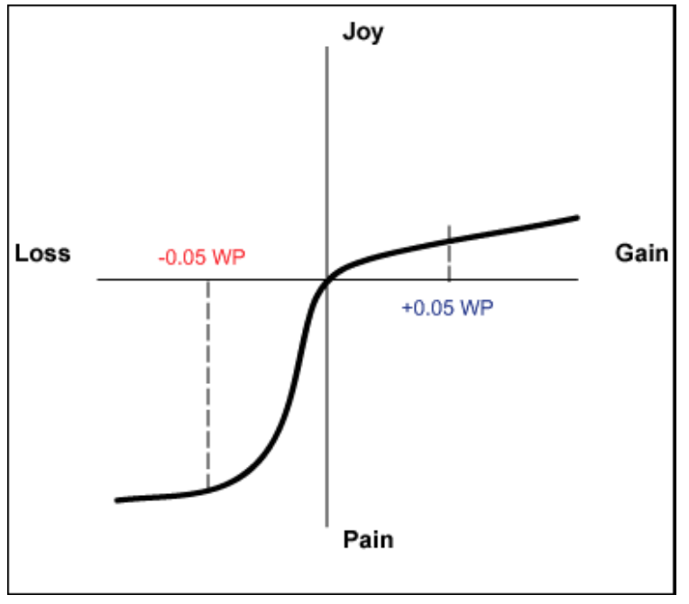
NFL Decisions: Prospect Theory
Prospect theory: humans make decisions based on value of losses and gains, and not on final outcome – and fear of losses outweighs equivalent gains.
Ex: Run versus pass

Slide 23
NFL Decisions: Risk aversion
Risk adverse: reluctance to accept bargain in favor of decision with more certain – but possibly lower - payoff
"Had we done that [gone for it] after what we had done to get down there and [not scored a touchdown], I can imagine what the critique would have been today about the play call.” – Brian Billick
“You guys might very well be right that we’re calling something too conservative in that situation. But what you guys don’t understand is that if I make a call that’s viewed to be controversial by the fans and the owner, and I fall, I lose my job” – Marvin Lewis
What was Mike Smith thinking
Ex: 4th and 2 from opponents 23

Slide 24
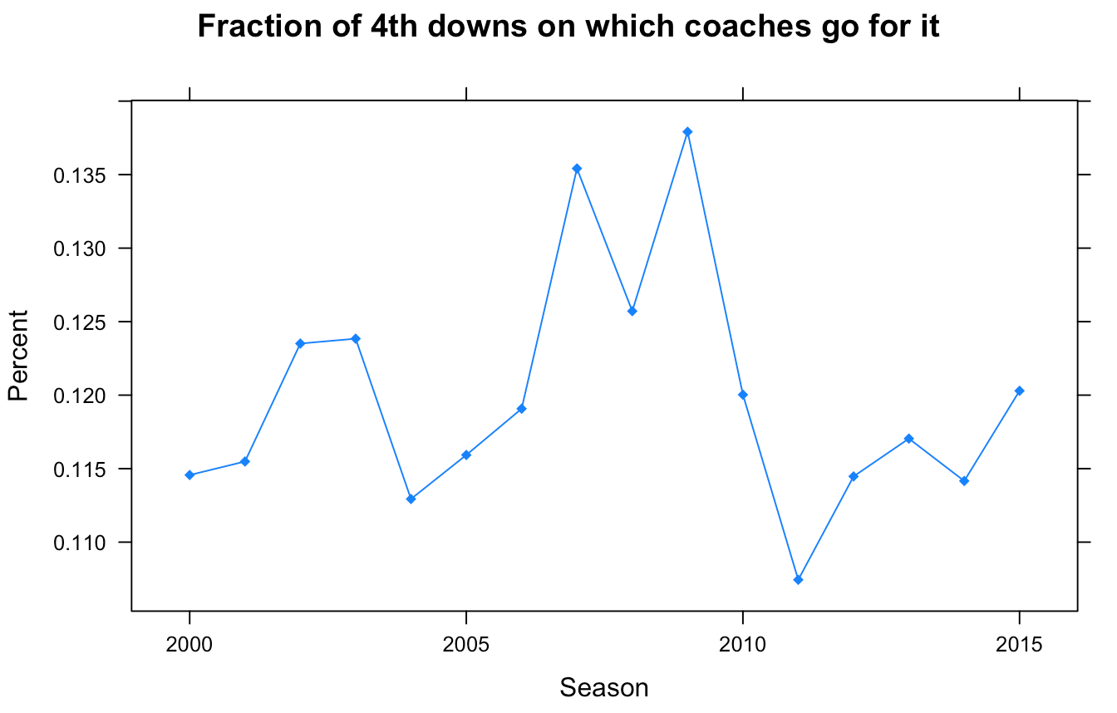
NFL Decisions:

Slide 25
NFL Decisions: Famous instances
Patriots vs. Colts, 2009
Packers vs. Cardinals, 2016
Saints vs. Falcons, 2011
Packers vs. Seahawks, 2015
Chiefs vs. Steelers, 2014
Lions vs. Cowboys, 2015

Slide 26
NFL Decisions: Famous instances
(i) Does article deal with expected points, win probability, or neither?
(ii) Does statistics back up the coaches’ decision or not?
(iii) Explain how statistics is or could be used in this scenario
(iv) Describe play (down, distance, time) and game (playoffs?) characteristics
(v) Identify possible heuristics at work

